Slide 1
Magdalini Kalopana, Musicologist, PhD.
Laboratory Teaching Staff
Department of Music Studies
National and Kapodistrian University of Athens
https://en.music.uoa.gr/staff/laboratory_teaching_staff/magdalini_kalopana/
Erasmus+ Mobility

Slide 2
42 departments, more than 239 postgraduate programs
Undergraduate Programs
Postgraduate Programs
Master Programs in Various Languages
Lifelong Learning
Summer Schools
https://en.uoa.gr/studies/

Slide 3
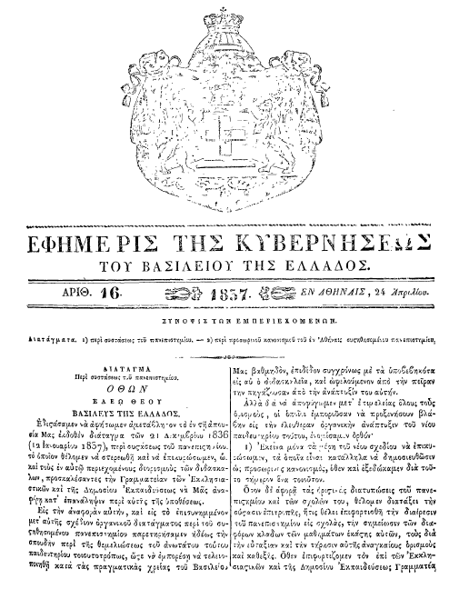
The establishment of the NKUA
The idea of establishing a University in Greece emerged alongside with the Greek War of Independence, also known as the Greek Revolution. The National and Kapodistrian University of Athens, officially founded in April 14th, 1837, is the first University not only of Greece but both the Balkan peninsula and the Eastern Mediterranean region.

Slide 4
A self portrait of the NKUA

Slide 5
NKUA places 89th in the world and 16th in Europe, marking a big jump in global University rankings
Important distinctions lay in store for the National and Kapodistrian University of Athens. The product of four authoritative global University rankings, these distinctions attested once more to the international standing of NKUA and its prominence among the Higher Educational Institutions in Greece and Southeastern Europe. Standing out are the appearances of NKUA in the top 100 of global University rankings and more specifically:
1. Our University’s 89th place in the world and 16th place in Europe according to ‘Top Universities by Top Google Scholar Citations’. Following the latest edition of this ranking and previous years’ results, the National and Kapodistrian University of Athens consolidates and enhances its place among the top 100 Universities worldwide.
2. NKUA’s 89th place in Immunology, and 100th place in Pharmacology & Toxicology worldwide in the ‘Ranking by Specific Subjects’ category of ‘NTU Rankings-Performance Rankings of Scientific Papers for World Universities’.
3. The climbing of the NKUA’s School of Medicine from the 101-150 bracket in 2022 to the 76-100 bracket (i.e., to the top 100 of Medical Schools worldwide) as far as the academic subject Clinical Medicine is concerned, according to the ‘Shanghai Ranking’s Global Ranking of Academic Subjects’. With this achievement the NKUA’s School of Medicine now ranks first among the four Greek Universities with Medical Schools on the List.
4. The inclusion of the NKUA’s School of Dentistry in the top 100 (the 76-100 bracket) of the ‘Shanghai Ranking’s Global Ranking of Academic Subjects’ in the subject Dentistry & Oral Sciences.It is worth noting that within 2017-2023, the School of Dentistry found itself four times in the top 100 and another three times in the 100-150 bracket.

Slide 6
UNIVERSITY | WORLD RANK Jan 2024 | COUNTRY RANK Jan 2024 | CITATIONS Jan 2024
National and Kapodistrian University of Athens | 89 | 1 | 4,285,020
Aristotle University of Thessaloniki | 272 | 2 | 1,910,120
University of Patras (incl. University of Western Greece) | 384 | 3 | 1,306,118
National Technical University of Athens | 404 | 4 | 1,220,547
University of Crete | 418 | 5 | 1,179,465
University of Thessaly | 472 | 6 | 1,007,389
University of Ioannina | 502 | 7 | 930,610
Democritus University of Thrace | 716 | 8 | 522,544
Agricultural University of Athens | 889 | 9 | 366,247
University of West Attica | 923 | 10 | 339,542
University of the Aegean | 946 | 11 | 322,009
Athens University of Economics and Business | 966 | 12 | 308,749
Technical University of Crete | 1,010 | 13 | 288,164
University of Piraeus | 1,266 | 14 | 179,830
Hellenic Mediterranean University | 1,440 | 15 | 140,223
University of Western Macedonia | 1,458 | 16 | 136,051
International Hellenic University | 1,496 | 17 | 129,568
University of the Peloponnese | 1,497 | 18 | 129,422
Harokopio University of Athens | 1,570 | 19 | 115,875
Hellenic Open University | 2,043 | 20 | 59,355
Ionian University | 2,090 | 21 | 56,689
Panteion University of Political and Social Sciences | 2,280 | 22 | 45,549
University of Macedonia | 3,217 | 23 | 16,165
School of Pedagogical and Technological Education | 4,486 | 24 | 3,930
Ranking of Greek Universities in Webometrics’ ‘Top Universities by Top Google Scholar Citations’ (January 2024)

Slide 7
9 SCHOOLS
SCHOOL OF AGRICULTURAL DEVELOPMENT, NUTRITION AND SUSTAINABILITY
SCHOOL OF ECONOMICS & POLITICAL SCIENCES
SCHOOL OF EDUCATION
SCHOOL OF HEALTH SCIENCES
SCHOOL OF LAW
School of theology
School of science
Scholl of physical education and sport science
SCHOOL OF PHILOSOPHY
DEPARTMENT OF GERMAN LANGUAGE AND LITERATURE
DEPARTMENT OF THEATRE STUDIES
DEPARTMENT OF SPANISH LANGUAGE AND LITERATURE
DEPARTMENT OF RUSSIAN LANGUAGE AND LITERATURE AND SLAVIC STUDIES
DEPARTMENT OF PSYCHOLOGY
DEPARTMENT OF PHILOLOGY
DEPARTMENT OF MUSIC STUDIES
DEPARTMENT OF ITALIAN LANGUAGE AND LITERATURE
DEPARTMENT OF HISTORY AND ARCHAEOLOGY
DEPARMENT OF FRENCH LANGUAGE AND LITERATURE
DEPARTMENT OF ENGLISH LANGUAGE AND LITERATURE
DEPARTMENT OF PHILOSOPHY
DEPARTMENT OF EDUCATIONAL STUDIES
PROGRAM IN THE ARCHAEOLOGY, HISTORY AND LIERATURE OF ANCIENT GREECE
SCHOOL OF PHILOSOPHY
The School of Philosophy of the University of Athens is the most populous University School of Greece and consists of 14 Deparτments and 15 study halls. The School offers a wide variety of studies in the fields of: classical and modern Greek, linguistics and literature of foreign cultures, classical and modern history, archaeology, pedagogy, psychology, slavic studies, theatrology and music.

Slide 8
SCHOOL OF PHILOSOPHY DEPARTMENT OF MUSIC STUDIES
The Department of Music Studies is part of the School of Philosophy of the National and Kapodistrian University of Athens. The Department has a strong research profile in all scientific disciplines pertinent to music and musicology.
Historical and Systematic Musicology
Ethnomusicology and Cultural Anthropology
Sound Technology
Byzantine Musicology
Music Pedagogy
+ musical instrument specialization in art, traditional and popular-jazz music

Slide 9
LABORATORIES
The Department has six (6) Laboratories and a professional Recording Studio:
The Laboratory for the Study of Hellenic Music, which is part of the Historical and Systematic Musicology sector. Laboratory Director: Professor Nikolaos Maliaras.
The Laboratory of Ethnomusicology and Cultural Anthropology, which is part of the Ethnomusicology and Cultural Anthropology sector. Laboratory Director: Professor Maria Papapavlou.
The Laboratory of Music, Acoustics and Technology, which is part of the Sound Technology, Music Education and Byzantine Musicology sector. Laboratory Director: Professor Anastasia Georgaki.
The Laboratory of Music Pedagogy, which is part of the Sound Technology, Music Education and Byzantine Musicology sector. Laboratory Director: Professor Smaragda Chrysostomou.
The Laboratory of Byzantine Musicology, which is part of the Sound Technology, Music Education and Byzantine Musicology sector. Laboratory Director: Professor Achilleas Chaldaeakes.
The Laboratory of Music, Cognitive Sciences and Community, which is part of the Sound Technology, Music Education and Byzantine Musicology sector. Laboratory Director: Associate Professor Christina Anagnostopoulou.
DEPARTMENT OF MUSIC STUDIES

Slide 10
Laboratory for the Study of Hellenic Music
https://hellenic-music-lab.music.uoa.gr/en/

Slide 11
“Polymnia” Archive
https://polymnia.music.uoa.gr/admin

Slide 12
Thank you for your attention!
Magdalini Kalopana
mkalopana@music.uoa.gr

